Slide 1
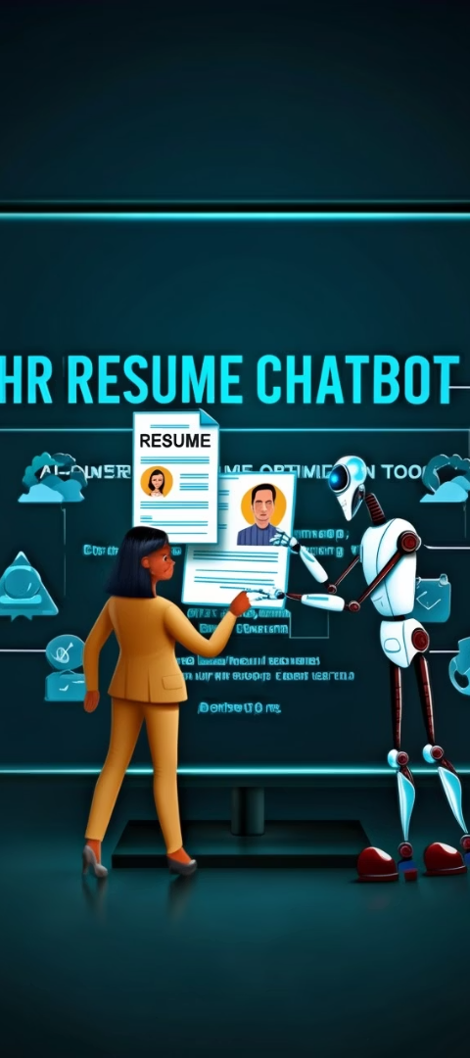
Title Slide
Project Title: HR Resume Chatbot
Subtitle: AI-Powered Resume Optimization Tool
Your Name: Ahmed Ragab Desouki Mohamed
Institution: DEPI (EYouth)
Date: 5/16/2025S

Slide 2




Project Idea
Problem: Job seekers often struggle to tailor their resumes for specific roles, leading to missed opportunities and low interview rates.
Proposed Solution: An AI-powered web app that analyzes resumes, matches them with job descriptions, scores them, and provides actionable suggestions for improvement. It also features a chatbot for interactive guidance.
Unique Value Proposition: Unlike generic resume tools, our chatbot offers personalized, LLM-driven insights, job title recommendations, and resume tips—delivered in real-time through a user-friendly interface.

Slide 3
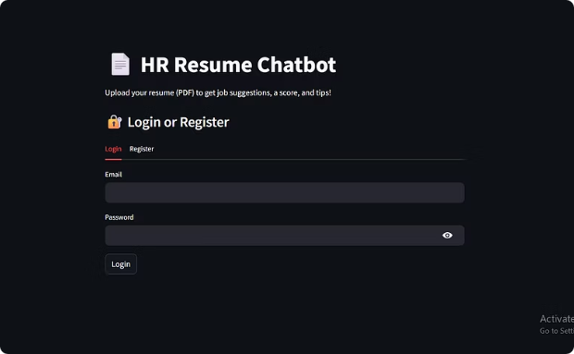
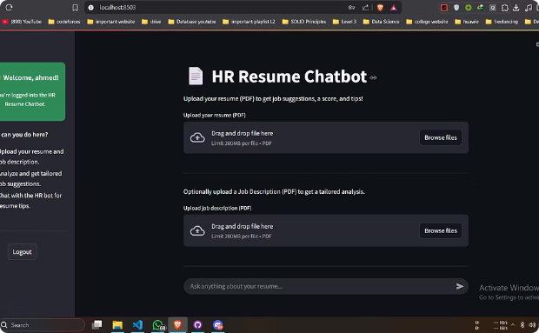
Project Wireframe
Title: Project Wireframe & User Journey
Login/Register Page: Users start by registering or logging in to securely access the platform.
Clean UI: Simple and dark-themed interface ensures focus and ease of use.
User Journey Summary: Sign up or log in.
Upload resume and optionally a job description.
View analysis with score, job titles, and improvement suggestions.
Chat with the AI assistant for personalized help.
Review or clear chat history at any time..

Slide 4
👥 End Users + Features
🎯 Primary End Users:
🛠️ Key Features
Job Seekers: Individuals looking to improve their resumes and land better jobs.
Feature
User Need Solved
Fresh Graduates: Those with limited experience needing targeted resume advice.
✅ Resume Upload & Analysis
Helps users evaluate their resume quality automatically.
Career Switchers: Professionals aiming to align their resumes with new roles.
✅ Job Description Matching
Matches resumes to specific job posts for better alignment.
✅ Resume Score & Tips
Provides actionable feedback to boost resume effectiveness.
✅ Relevant Job Titles
Suggests roles based on resume content and strengths.
✅ Interactive Chatbot
Allows users to ask questions and get guidance in real time.

Slide 5
Data Structure
🧱 Database Architecture:
Type: Relational Database (SQLite)
Why: Lightweight, easy to integrate with Streamlit, suitable for user-based applications.
🔑 Key Entities & Relationships:
Entity
Description
Users
Stores user credentials and profile details
Resumes
Stores uploaded resume metadata and text
Job Descriptions
Stores uploaded job descriptions
Chat History
Records chatbot-user conversations per session
Resume Scores
Stores feedback, scoring, and suggestions

Slide 6







📈 Data Flow Overview:
Uploads Resume/Job Description
User Registers/Logs in
2
1
3
Data Stored in SQLite DB
Conversation Logged
7
4
Model Processes Resume
6
User Queries via Chatbot
5
Feedback + Score Displayed

Slide 7
🧑‍💻 Programming Languages + Frameworks
📝 Programming Languages:
Python: Core language for backend logic, data processing, and AI integration.
🛠️ Frameworks & Tools:
Streamlit: Web app framework for building the UI quickly and interactively.
SQLite: Lightweight database for user authentication and chat history.
LangChain: Enables LLM-powered interactions and memory management.
PyPDF2 / pdfminer: For parsing and extracting text from PDF resumes.
Scikit-learn & SpaCy: For NLP tasks and scoring algorithms.
🌐 Supporting Technologies:
OpenAI API: Powering the chatbot and resume analysis using large language models.
GitHub: Version control and project collaboration.

Slide 8
Slide 8: Deliverables
Reports and Documentation:
project pdf : Link
README file : Link
Timeline for Deliverables:
Week 1–2: Project Planning & Requirements
Week 3–4: System Design & Development
Week 5: Testing & Debugging
Week 6: Final Report & User Documentation Submission
Week 7: Presentation and App Deployment
Other Final Products:
Source Code Repository (GitHub)

Slide 9
Team Members & Roles:
[Ahmed Ragab] – Team Leader
[Malak Mohamed]
Project coordination and version control (GitHub).
Works on resume analysis and scoring logic
Build classical ML and Designed user authentication.
participate in classical ML
participate in LLMs
[Zeyad Abo Alsoud]
[Remon Raafat]
participate in classical ML
Build the frontend components using Streamlit (app.py)
Enhances user experience
Develops database and API, build the chat bot, LLMs.
[Mohamed Osama Nabil] – Tester
participate in classical ML
Conducts testing phases and tracks bugs
[Malak Gamal Eldin]
Prepares user manuals and project reports
participate in Classical ML.
build the Resume Barser & Chat memory

Slide 10

Thank You! 🙏
We appreciate your time and attention.
📩 Contact Information:
Team Lead: Ahmed Ragab & Remon Raafat
Email: ahmedragab.work1@gmail.com
GitHub: github.com/A7medrajab1/resume-screening
💬 Questions or Feedback? We’re happy to answer and improve—your feedback is valuable!

